Slide 1

Bus Reservation System
ReserveUrRide.com
Group 5 Team:
Nishi Jain
Anurag Singh
Mithilesh Joshi
Sanjana Minocha
Rasee Ranjan
Charu Yadav
Chaitanya Joshi
Ateev Agarwal

Slide 2
Introduction
Bus Reservation System helps you find bus routes and tours with ease.
The system allows you to plan, schedule and manage unlimited routes with start and end destinations, show bus schedules with the departure times of all buses of a specific route, seat details.
Select various bus types, show seats number and a seat layout.
Select multiple bus routes with boarding and arrival points.
View seats details with passenger details.

Slide 3
Problem Statement
Existing system is totally on book and thus a great amount of manual work has to be done. The amount of manual work increases exponentially with increase in services.
The proposed system is user friendly and it has got following features:
User can book ticket anytime from anywhere with ease.
Records are efficiently maintained by DBMS which provides security for the information.
Availability of seats can be enquired very easily.
Passengers can also cancel their tickets easily.
In existing system, there are various problems like keeping records of items, seats available, prices of per/seat and fixing bill generation on each bill.
Finding out details regarding any information is very difficult, as the user has to go through all the books manually.
Major problem was lack of security.

Slide 4
Features
Allows user to filter the buses on the basis of:-
travel date,
category of the bus,
arrival time and departure time.
Allows user to plan journey according to availability of time and seats in buses.
Allows user to select seats of his choice from the layout of the bus.

Slide 5
Technologies Used
HTML5, CSS3, Bootstrap(v 3.3.7)
JavaScript(v 1.8.5)
Angular JS(v 1.7)
REST Services
Spring MVC(v 4.0.9)
Spring IOC
Hibernate (v 4.3)
Oracle Database (10g)

Slide 6
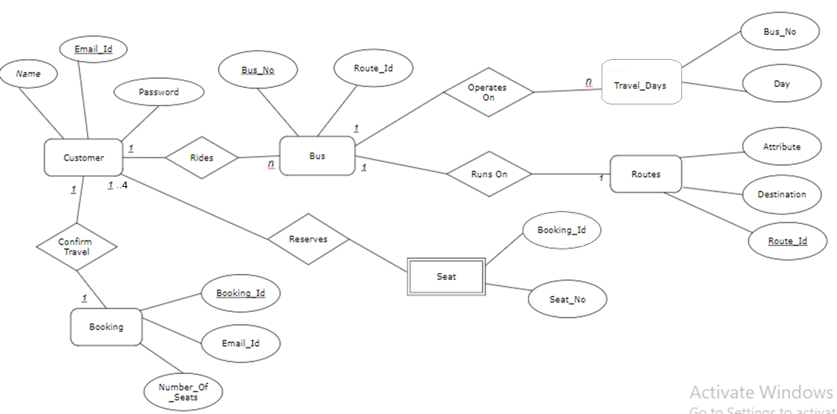
ER Diagram

Slide 7
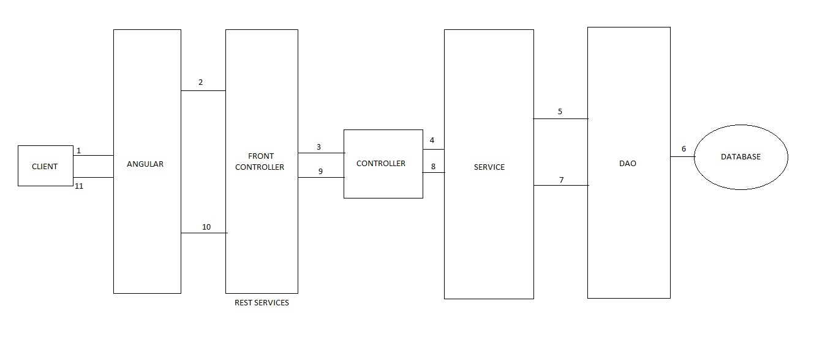
Web Architecture

Slide 8
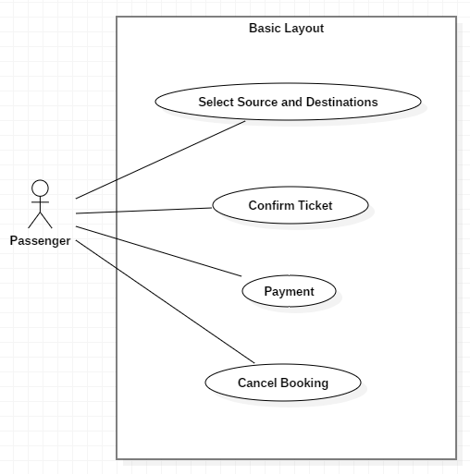
UML Diagrams
Use Case:

Slide 9
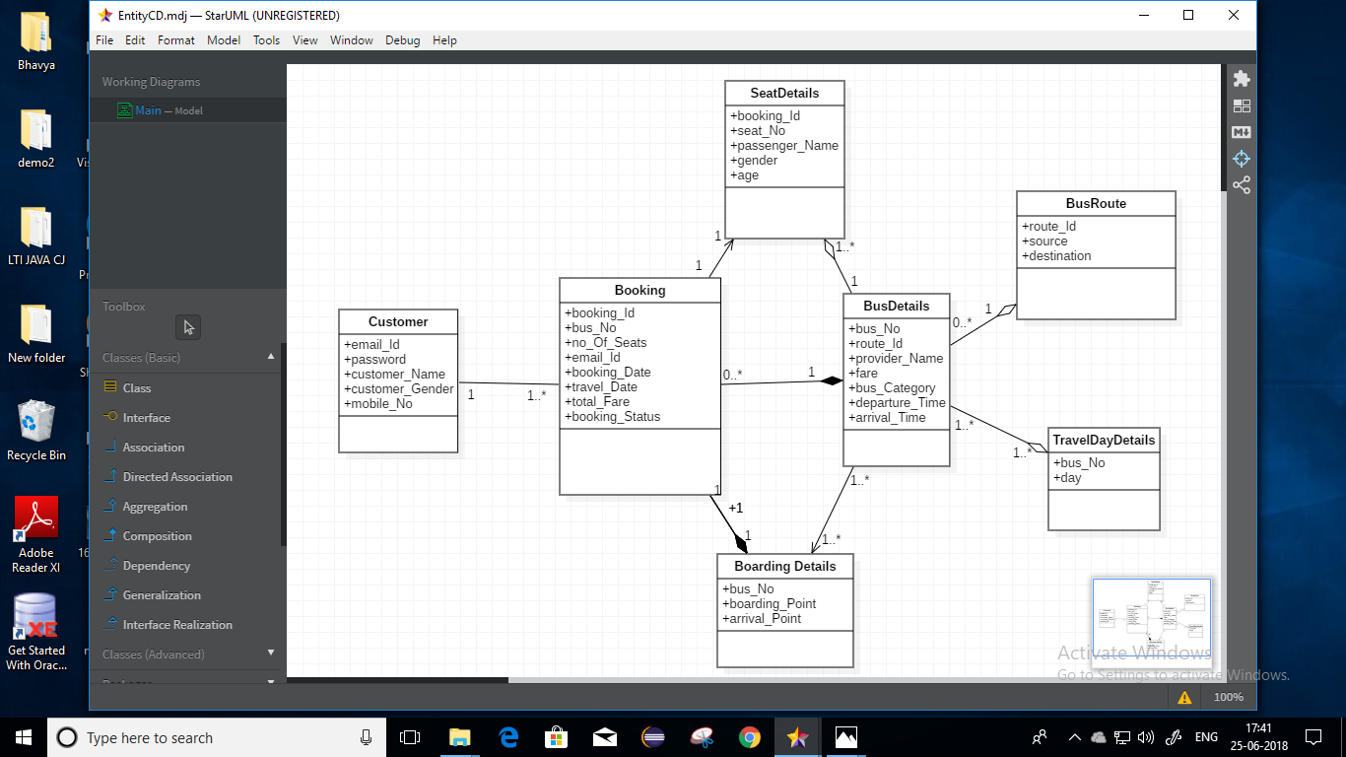
Continue…
Class Diagram(Entity):

Slide 10
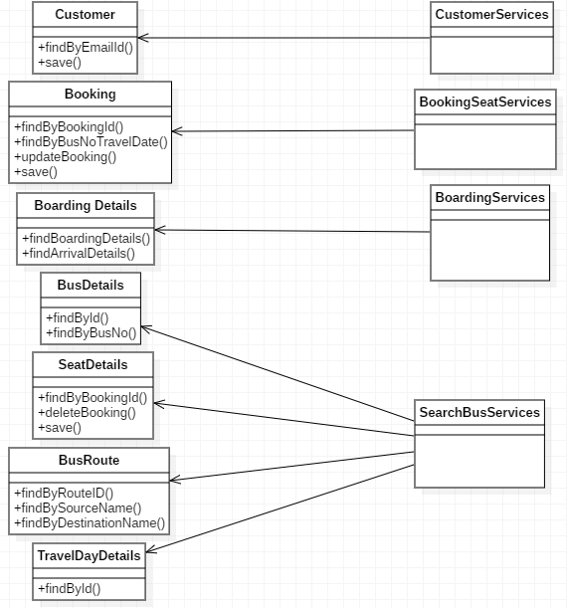
Continue…
Class Diagram(DAO):

Slide 11
Enter passenger details
Continue…
Select source, destination and traveling date
Book and Confirm Tickets
Activity Diagram:
Select Bus
Payment
LogIn/Sign up
Successful
No
Successful
No
Print and View ticket
Yes
Select seat
No
Successful
Yes

Slide 12
Future Scope
Facility of tracking the bus.
Inclusion of payment gateway.
Priority for reserving seats for senior citizens and specially abled people.
Prioritizing the booking for different genders based on the seat booked.

Slide 13
Conclusion
In the present era due to huge amount of data, handling them manually is not feasible and the same is true for bus reservation facility.
Managing this data through online system provides ease not only to the customers but also to the bus providers.
Using this system assures data consistency of all the users which is a major drawback of manual system.
In future after the amalgamation of tracking facility, security of the travelers will also increase by many folds.

Slide 14
Thank You

